Slide 1
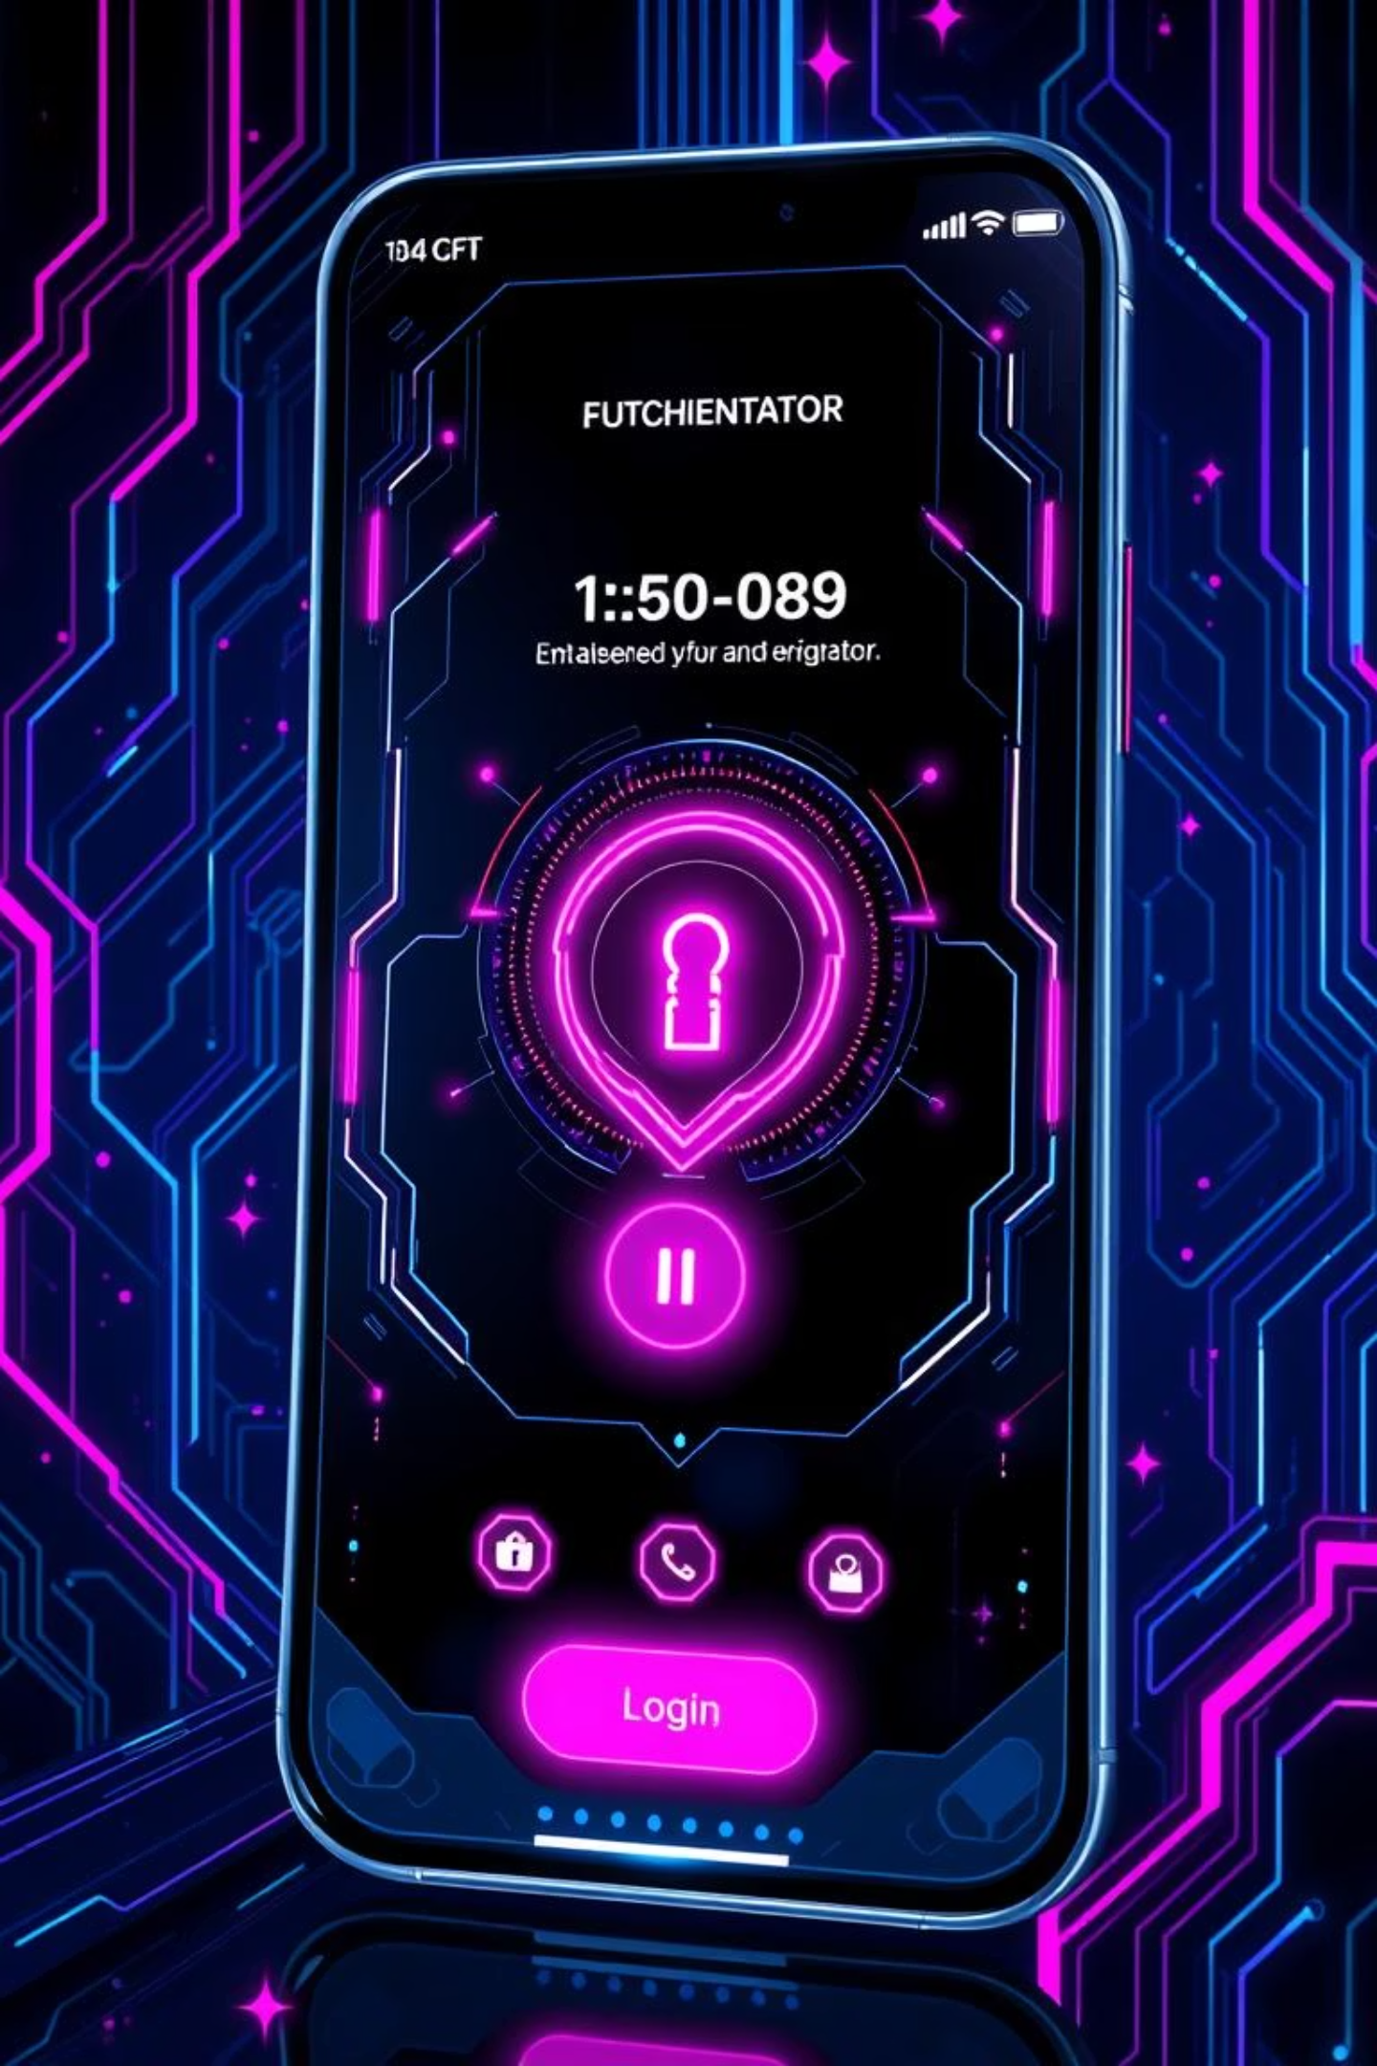
The Authenticator Application
By Nikhil Bagul , Nilesh Kandhari , Vinayak Khurade

Slide 2

Abstract: Secure 2FA System
This project presents a secure, web-based Two-Factor Authentication (2FA) system using React (frontend) and FastAPI (backend). It enhances traditional authentication with Time-based One-Time Passwords (TOTP), allowing users to manage multiple accounts and scan QR codes with standard authenticator apps. The system prevents unauthorized access and strengthens account protection against cyber threats.

Slide 3
The Problem: Insufficient Security
"Over 80% of hacking-related breaches involve weak, reused, or stolen credentials."
Traditional username-password systems are vulnerable to phishing, credential stuffing, and brute-force attacks. This project addresses this critical security gap by implementing a web-based 2FA system using TOTP, adding a dynamic, time-sensitive layer of protection.

Slide 4
Project Objectives
1
2
Secure 2FA Web App
Multi-Account Management
Develop a complete 2FA solution using React and FastAPI.
Allow users to manage various 2FA-enabled services from one dashboard.
3
4
QR Code Enrollment
Seamless User Flow
Implement easy setup using QR codes for authenticator apps.
Enable smooth signup, login, and logout functionality.
5
6
Secure Token Storage
User-Friendly UI
Create a modern glassmorphism design with React.
Ensure secure storage of authentication tokens using JWT & localStorage.

Slide 5





Key Technologies & Standards
RFC 6238 (TOTP)
Authenticator Apps
OAuth 2.0 & JWT
Time-based One-Time Password algorithm for dynamic code generation.
Compatibility with Google Authenticator & Microsoft Authenticator.
Secure API authentication and stateless token management.
React 18
FastAPI
Frontend development with component-based architecture.
High-performance Python web framework for the backend.

Slide 6
Implementation Highlights
Frontend (React)
Backend (FastAPI)
User Authentication Form (AuthForm.jsx)
/signup – User Registration
Dashboard with QR Code management
/login – User Login (with 2FA trigger)
JWT token-based access control
/verify-otp – TOTP verification
Glassmorphism UI with TailwindCSS
/accounts – Manage TOTP-enabled accounts
/add-account – Generate QR Code
Security is ensured through JWT-based authentication, secure token storage, and server-side TOTP validation using pyOTP.

Slide 7
Results & Observations
100%
150ms
30s
OTP Accuracy
API Response
TOTP Refresh
Successful verification for valid codes.
Average response time for API calls.
Codes refresh every 30 seconds, RFC 6238 compliant.
The system demonstrated successful login with 2FA enforcement, multi-account management, and a responsive, dark-mode optimized interface.

Slide 8
Ethical Impact
Enhanced User Privacy
Data Security Compliance
Reduced Cyber Threats
Reduces cyberattack risks and never stores passwords in plaintext.
Adheres to GDPR-like principles and OWASP Authentication Guidelines.
Lowers the barrier for robust authentication, combating phishing and brute-force attacks.

Slide 9
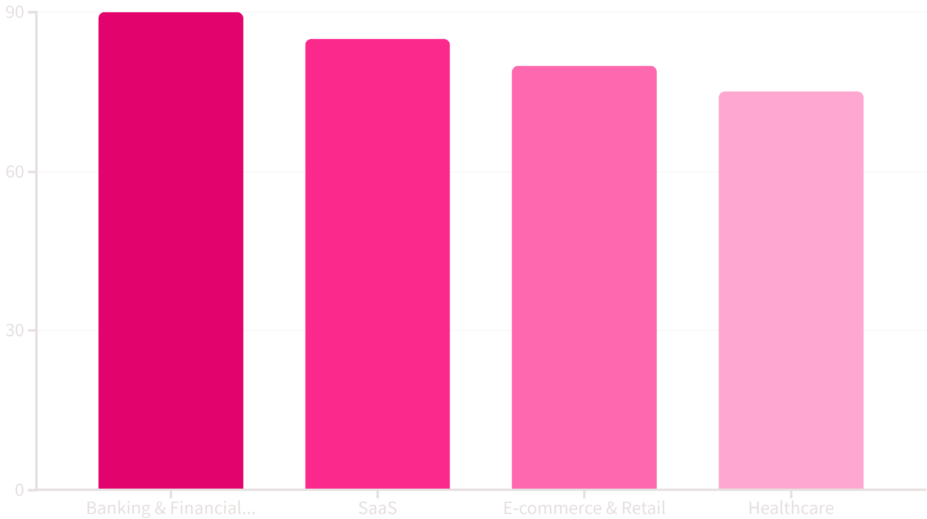
Market Relevance
The global MFA market is projected to grow significantly, with high demand in banking, SaaS, and e-commerce. This project offers a lightweight, open-source-friendly solution that can be integrated as a microservice, differentiating it from proprietary alternatives.

Slide 10




Future Scope
Mobile App Companion
Dedicated app for instant OTP access and push notifications.
Biometric Integration
Fingerprint and facial recognition for enhanced convenience and security.
Cloud Key Storage
Encrypted cloud-based storage for seamless device synchronization.
Role-Based Access
Granular access control for enterprise use cases.
FIDO2/WebAuthn Support
Integration for passwordless and hardware-backed authentication.

